Slide 1
Connecticut’s GHG Emissions Inventory
1990-2015

Slide 2
Goal
Provide an overview of CT’s GHG emissions from 1990-2015, the most recent year for which full data are available.
The statewide GHG emission inventory is an important tool for tracking Connecticut’s progress toward the goals set by PA-08-98.
Targets of reducing GHG emissions:
10% below 1990 levels by 2020
45% below 2001 levels by 2030
80% below 2001 levels by 2050

Slide 3
Data/Methods
Heavily based on the U.S. Environmental Protection Agency’s State Inventory Tool (SIT).
tool calculates sector-by-sector GHG emissions based on numerous state-level data sets
Default data is used most sectors, exceptions are:
solid-waste data from the DEEP municipal waste program
LULC and forestry default data not used => unreliable, questionable
consumption based accounting for the electricity sector based on MA DEP SGIT appendix Q-S methodology
National statistics and state data are used when appropriate from EIA and federal sources
State demographic & transportation data

Slide 7
Demographics:
2015 CT median age = 37.2 yrs
-7% change in 2015 GHG lbs/capita from 1990
GDP:
Post-2008 recession, GDP growth has been small (<2% /yr from previous year)
-60% change in 2015 GHG lbs/GDP from 1990

Slide 8
Electricity Sector Emissions
CT energy sector electricity consumption & generation were higher than in 2014:
From EIA: 2015 generation was 7% higher than 2014
From MA DEP: 2015 consumption was 4% higher
CT also exported MUCH more energy (includes energy used for pumping/storage)
Many REC imports were from biogenic sources, primarily wood/wood biomass
Consumed energy sources were also more GHG intensive
Shutdown of the 620-MW Vermont Yankee Nuclear power plant in December 2014?
For the ISO-NE region, the % of energy supplied from nuclear sources dropped by 4% from 2014 to 2015.
Regional emission factor:
across the ISO-NE region 2015 was brutally cold, more energy was used & generated.
Larger percentage of ISO-NE energy mix was from higher emission fuels.
Regional emission factor was higher than previous year.
Notes:
Connecticut’s largest GHG reduction since 1990 has occurred in the electric power sector —14.5% under consumption-based accounting and 25% under generation-based accounting.

Slide 9
Percent of ISO-NE Energy Generation
 | Net Energy (GWh)
 | Total | ME | NH | VT | CT | RI | MA
Load | 127,176 | 12,045 | 11,702 | 6,009 | 30,961 | 8,204 | 58,254
Generation | 108,357 | 9,945 | 19,815 | 6,466 | 28,453 | 10,705 | 32,974
 | Net Energy (GWh)
 | Total | ME | NH | VT | CT | RI | MA
Load | 126,955 | 11,924 | 11,699 | 5,929 | 31,071 | 8,225 | 58,107
Generation | 107,916 | 8,867 | 20,313 | 1,436 | 35,087 | 8,395 | 33,817

Slide 10
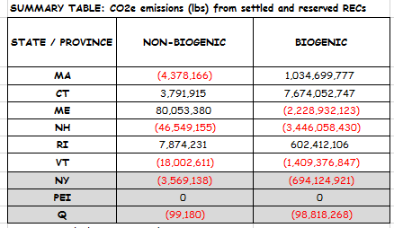
Biogenic Fuel
Emission Factors from MA DEP methodology
 | New England
Non-biogenic GHG Emission Rate (lb/MWh) | 531 (521)
Biogenic GHG Emission Rate (lb/MWh) | 157 (146)
Total | 688 (+3%)
Notes:
Emission factors:
Emission factors provide a useful shortcut for use in life-cycle assessment, avoiding the need for detailed calculations of emissions. An emission factor is a typical quantity of GHGs released to the atmosphere per unit of activity (lb/MWh).
The regional (ISO-NE) regional factor is based on the regional mix of fuels. For 2015, the mix had a higher percentage of dirty fuels due to a very cold prolonged winter.

Slide 12
Imported Wood Fuel
For 2015, imported wood fuel generated 35,615,057 MMBtu of energy.
10% reduction => CT biogenic emission factor decreases by 19 (lb/MWh).
10% reduction => NE regional emission factor decreases by 5 (lb/MWh).
20% reduction => NE regional emission factor decreases by 11 (lb/MWh).
Notes:
For 2015,

Slide 14
New England Winter 2015
2015 was the coldest January-March on record, particularly February

Slide 17
Emissions and climate
Residuals:
Min 1Q Median 3Q Max
-1.47722 -0.34842 0.03994 0.35763 1.35640
Coefficients:
Estimate Std. Error t value Pr(>|t|)
(Intercept) 11.49776 0.14468 79.472 < 2e-16 ***
CT_FEB 0.15197 0.03803 3.996 0.000773 ***
CT_APR -0.17363 0.09758 -1.779 0.091174 .
CT_JUL -0.14843 0.07139 -2.079 0.051379 .
CT_SEP 0.33104 0.09156 3.616 0.001842 **
CT_NOV 0.19299 0.06372 3.029 0.006906 **
CT_DEC -0.06692 0.04076 -1.642 0.117055
---
Signif. codes: 0 ‘***’ 0.001 ‘**’ 0.01 ‘*’ 0.05 ‘.’ 0.1 ‘ ’ 1
Residual standard error: 0.7029 on 19 degrees of freedom
Multiple R-squared: 0.6678, Adjusted R-squared: 0.5629
F-statistic: 6.366 on 6 and 19 DF, p-value: 0.00084

Slide 18
Looking Forward into 2016, US
Total U.S. emissions decreased from 2015 to 2016 by 1.9%.
The decrease in CO2 emissions from fossil fuel combustion was largely due to:
large scale substitution from coal to natural gas and other non-fossil energy sources in the electric power sector; and
warmer winter conditions in 2016 resulting in a decreased demand for heating fuel in the residential and commercial sectors.
Connecticut=>winter temperatures were 5-6 degrees Fahrenheit above average.

Slide 20
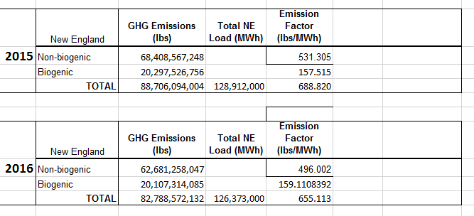
Electric Sector, New England Emissions

